Slide 1
News Downloads and Text Coverage: Case Studies in Relevance
Mike Scott
Lexical Analysis Software
Aston University
Edge Hill corpus research group
30 March 2023

Slide 2
Outline
analysis of text downloaded from text archives in terms of content and relevance
themes: ambiguity, uncertainty, overlap
problems: difficult to predict relevance, relevance depends on research aims

Slide 3

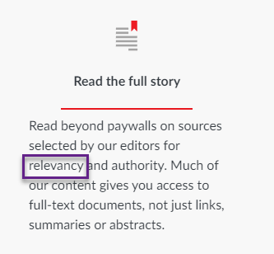
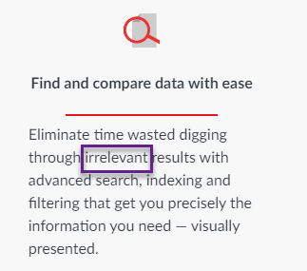
https://www.lexisnexis.co.uk/products/nexis.html

Slide 4
Research Questions
What is the relevance in news search results for water, climate, water+climate etc. of a news text database?
What can a key words database show us about the nature of such texts?
How highly do such texts score on relevance to a topic encapsulated by a word like water or climate?
To what extent can an automated process determine relevance?

Slide 5
collaboration
with Michaela Mahlberg and her colleagues at Birmingham on the NERC-funded Water Discourses project
https://www.birmingham.ac.uk/news/2022/water-day-2022

Slide 6



WordSmith 8 (64bit) main tools used
Corpus Checker
WordList
KeyWords

Slide 7
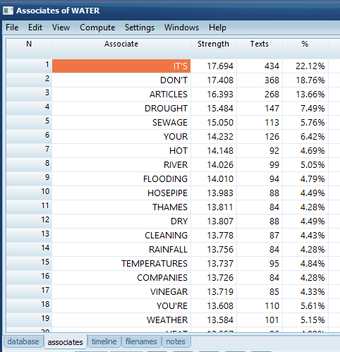
8.8K texts on “water”
Associates of “water”
water is key in 1,962 “water” texts
3/4 of the “water” texts don’t have water as a KW

Slide 8
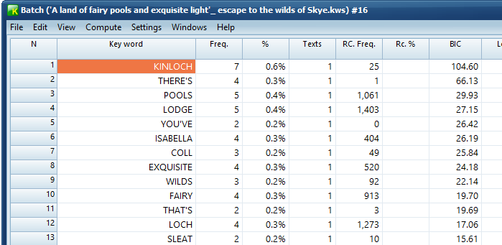
a text without water as a key word
waters (2)
water (1)

Slide 9
water
experts
sewage
litres
river
flood
weather
vinegar
hack
hot
drought
clean
stain

Slide 10
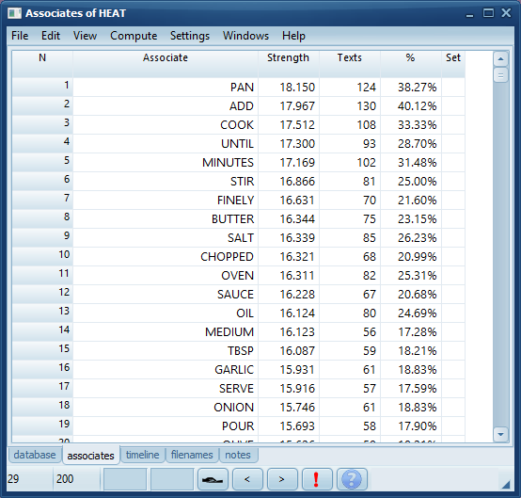
Associates of heat
heat is key in 324 “water” texts

Slide 11
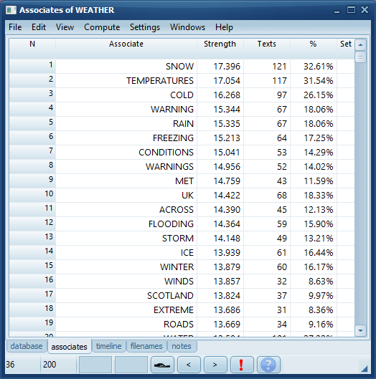
Associates of weather
weather is key in 371 (4%) “water” texts

Slide 12
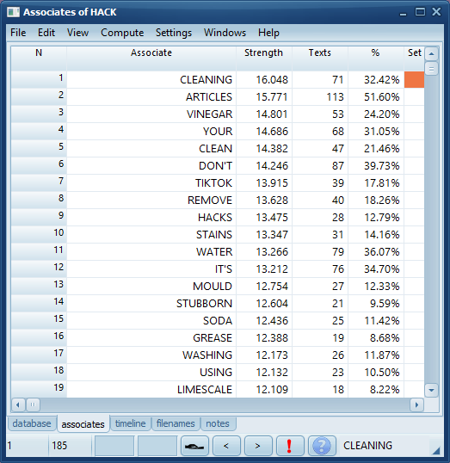
Associates of hack
hack is key in 219 (2%) “water” texts

Slide 13
water
is not a simple term
Cobuild dictionary 1987:
  9 basic meanings related to liquid plus 1 metaphorical (in deep waters), 12 expressions like water on the brain, head above water, oil on troubled waters
  separate entries: water down, water bird, water biscuit to watery

Slide 14
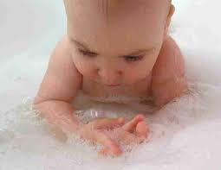

Problem: a matter of distinguishing between

Slide 15




Standard text databases
Large numbers of texts e.g. news articles
Problems:
  redundancy
  repetition
  relevance
Wanting to get text which truly relates to a topic

Slide 16

Clean-up
removing duplicate file-names
removing duplicate content
approx. 10% of files were duplicates
some duplication within texts too, not handled

Slide 17

the baby
texts which are really about the topic searched for

Slide 18

the bathwater
whole texts which only incidentally mention the topic
extraneous or wrongly repeated chunks in texts

Slide 19
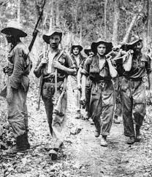
what a text is really about
Daily Telegraph headline:
Captain Richard Hilder; Officer who had a close shave when a bullet hit his water bottle during Chindit operations in Burma.
Obituary of Hilder who died in October 2022 aged 101

Slide 20
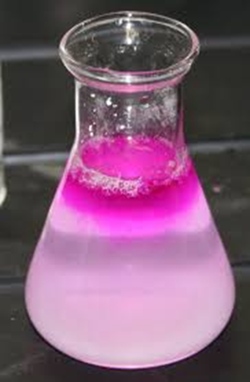
Relevance Filtering
processing thousands of texts
scoring each one
for its relevance to the topic

Slide 21


bag of words
on my way to the market
way
market
to
the
my
on

Slide 22
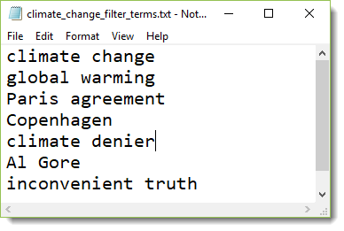
1. relevance check - manual
seek pre-defined search strings
add or subtract points if found
and if well spread through text
computes a score for each text counting positive and negative points in relation to length of text

Slide 23

manual selection of strings
crude assumption that word forms indicate text meaning

Slide 24
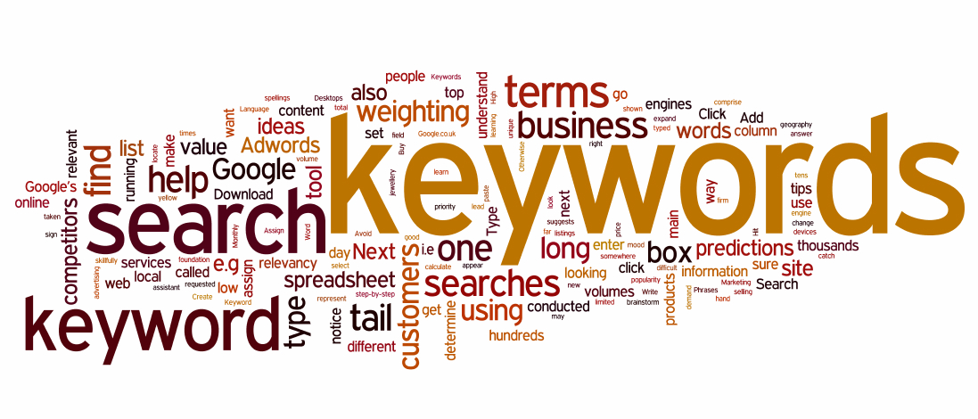
Corpus method to complement manual selection

Slide 25
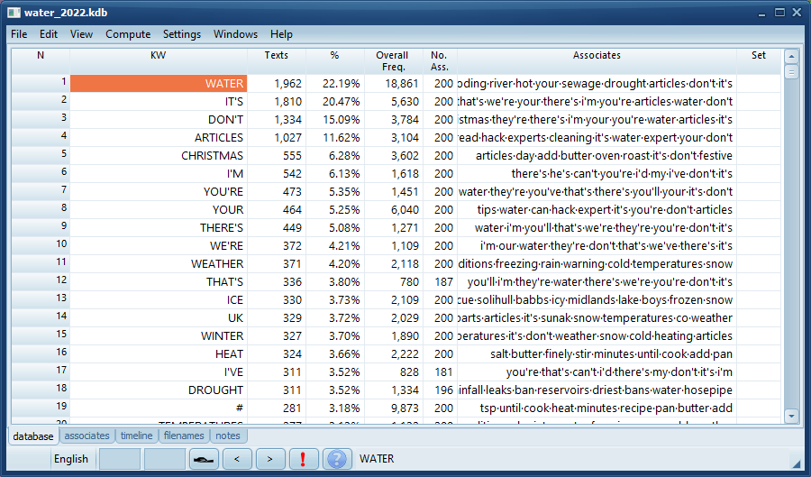
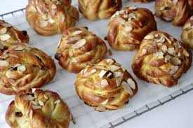
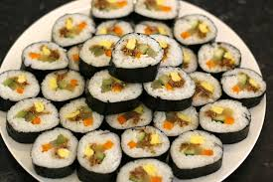
make word lists of all texts
make key word lists
build a kw database

Slide 26
Associates
i.e. key in the same texts as water

Slide 27

factors in computing association
number of texts word 1 is key in
number of texts word 2 is key in
number of texts both words are key in
number of texts in the database

Slide 28
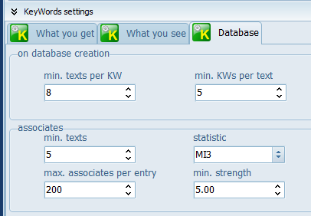
associate strength
Computed using MI3 statistic with minimum of 5.0

Slide 29
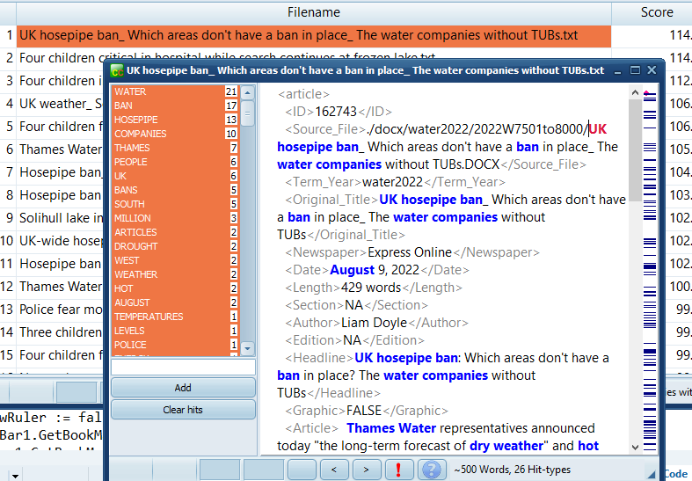
texts scored by association strength

Slide 30
automatic selection of strings
same crude assumption that word forms indicate text meaning
bag of words processing
uses associates from a key word database as terms for filtering

Slide 31
How relevance is computed
<mark-up>-free version of each text
requirements
  a) minimum word count
  b) presence in a minimum number of segments
points added for each hit, total points minus any deducted.
hits per 1000 tokens used in computing the score, plus number of segments covered

Slide 32
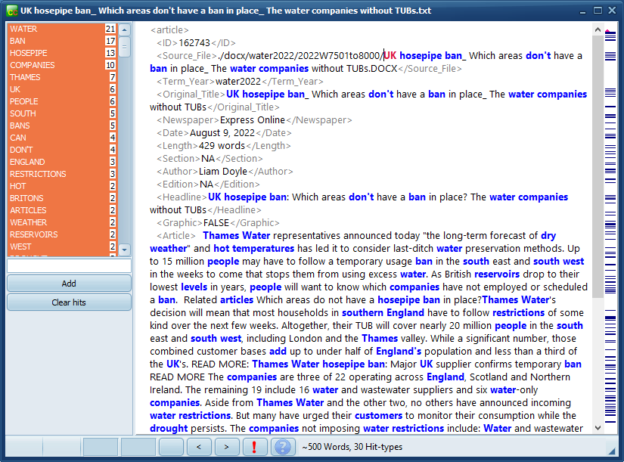
Score: 127
heatwave and hosepipe ban

Slide 33
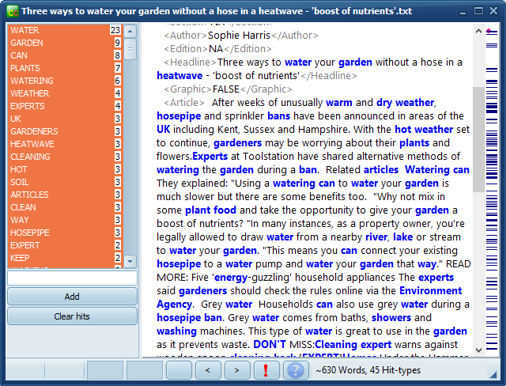
Score: 97.6
water your garden

Slide 34
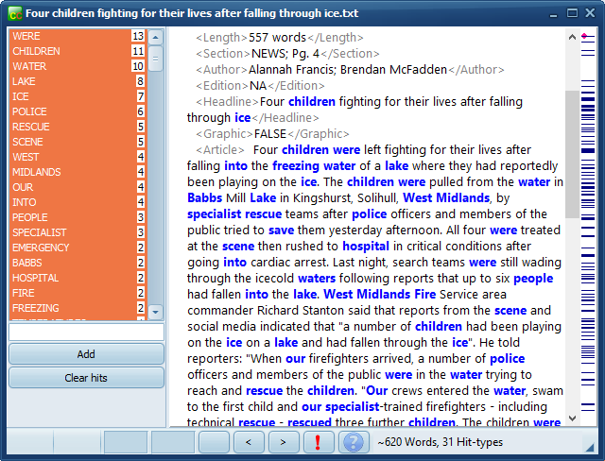
Score: 87.9
children nearly drown

Slide 35
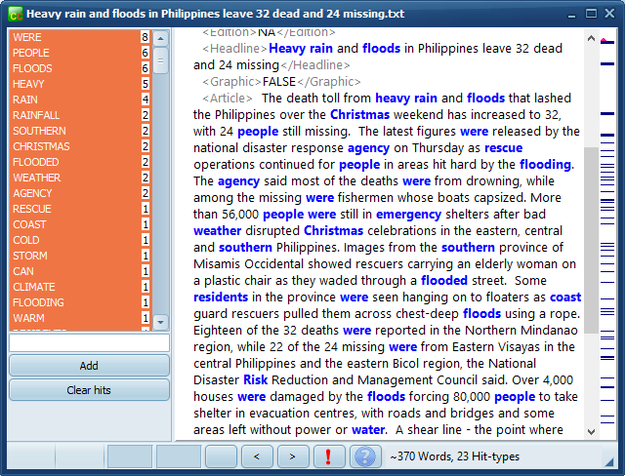
Score: 69.9
weather, rain & flooding

Slide 36
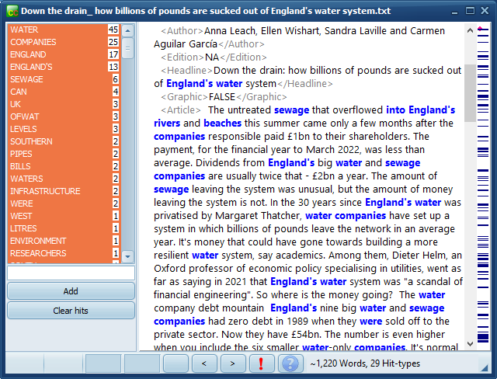
Score: 59.2
water company finances

Slide 37
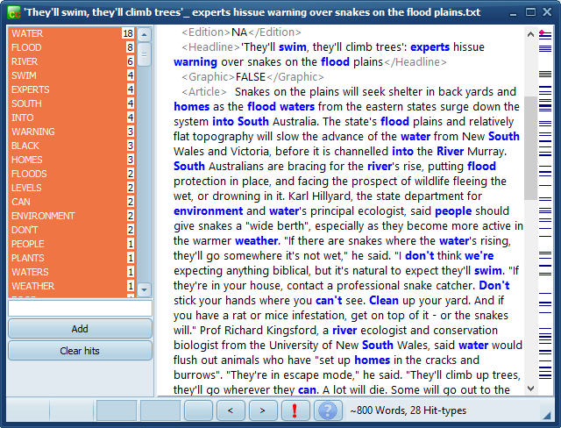
Score: 49.9
snakes on the flood plains

Slide 38
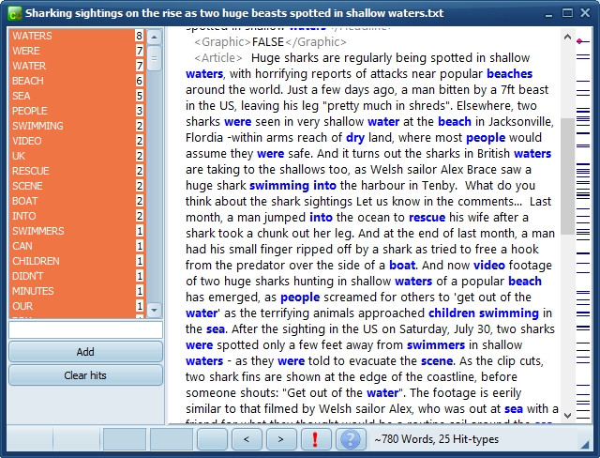
Score: 39.7
shark attacks

Slide 39
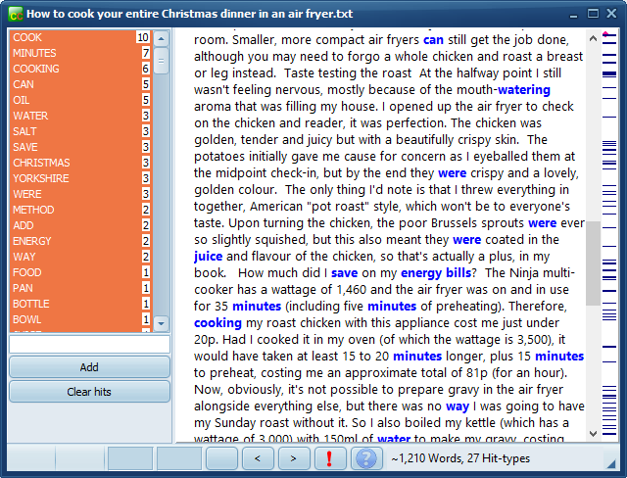
Score: 29.3
cooking Christmas dinner

Slide 40
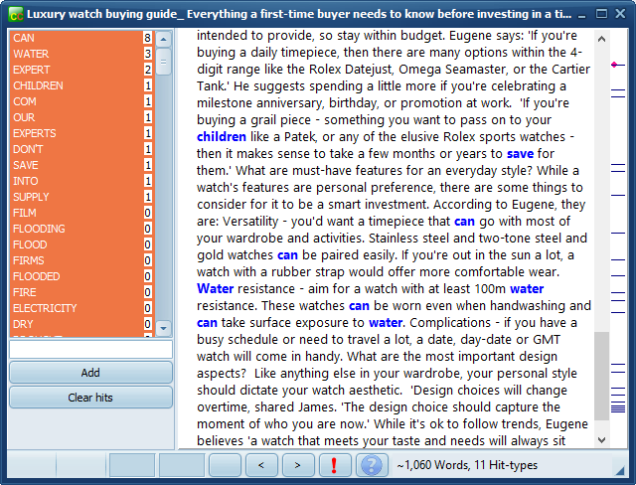
Score: 9.9
choosing a watch

Slide 41
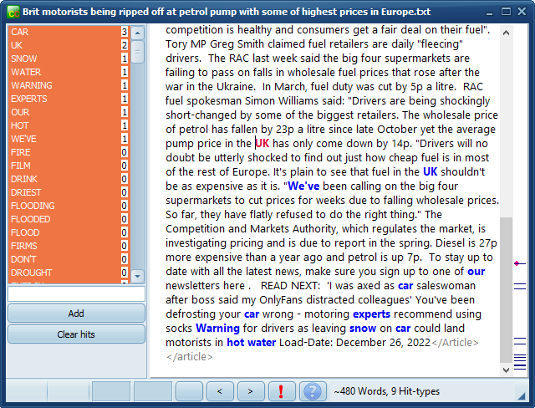
Score: 0.0
petrol prices

Slide 42
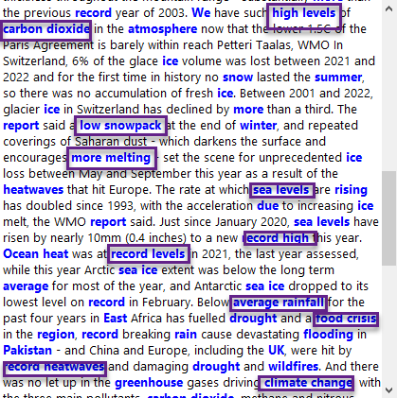
Refinements
Examine texts with high or scores to refine the filter list:
multi-word units (climate change, global warming) etc.

Slide 43
Why so few relevant texts?
black-box methods of the standard text provider: is a search merely the presence of the search-term?
if so, a search on water could possibly retrieve texts containing pool, lake but not water.
Do all water texts contain water?
Do we find some with eye-wateringly, water under the bridge, Muddy Waters the blues-singer, and no other reference to water?

Slide 44

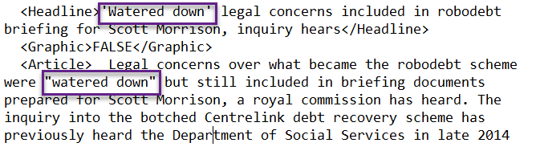
word lists without water

Slide 45
Genre?
Are some genres very unlikely to contain texts centrally about water because of their function? Sports reports? Obituaries? Travel and holiday recommendations?

Slide 46
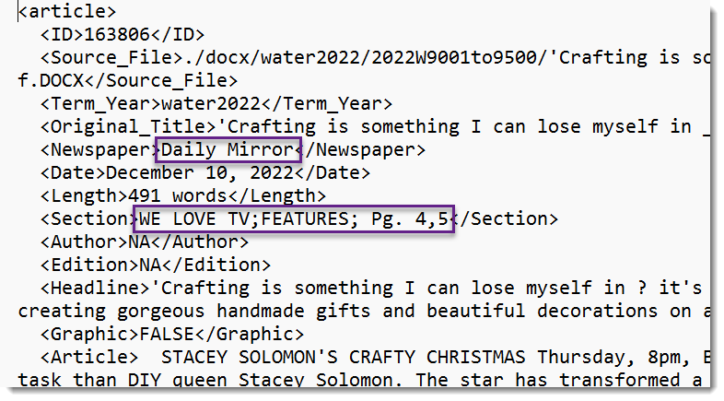
breakdown of scores
by any header in the text corpus

Slide 47

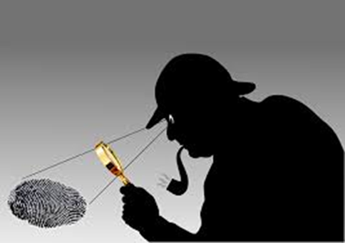

work in progress
need to calculate precision and recall for both methods
combine both methods
Method 1 uses more human input
but all research requires human intuition, interpretation, deductive powers

Slide 48
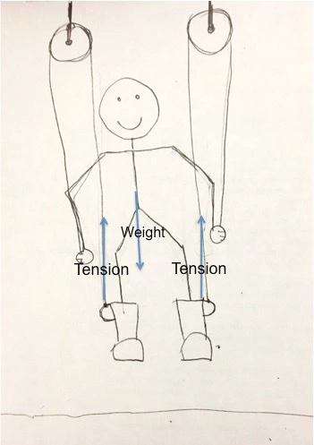
… finding true climate change texts means presupposing the outcome of this research
the bootstrap problem
Khayrallah, 2016

Slide 49
References & Related Sources
Dayrell, C., M. Muller, M. C. Caimotto, S. Piao, 2016. Discourses around climate change in the news media. Corpora and Discourse International Conference - Siena, Italy.
Dayrell, Carmen, 2015. Working Paper #1 The Brazilian Corpus on Urban Violence, http://cass.lancs.ac.uk/wp-content/uploads/2015/11/Working-paper-1-Corpus-Compilation.pdf
Bednarek, Monika & Helen Caple, 2017. The Discourse of News Values: How news organisations create newsworthiness. New York : Oxford University Press.
Gabrielatos, Costas, 2007. Selecting query terms to build a specialised corpus from a restricted-access database. ICAME Journal Vol 31, 5-44.
Khayrallah, Nadia, 2016. Blog. https://nadiainherownworld.wordpress.com/2016/01/21/so-you-think-you-can-pull-yourself-up-by-your-bootstraps-a-physics-problem/
Lee, Kelvin, 2023, Introducing the Document Similarity Tool: a new toll for corpus building. https://github.com/Australian-Text-Analytics-Platform/document-similarity#readme ; https://www.atap.edu.au/posts/similarity-tool
Malone, Dan, 2023, Developing a Complex Query to Reduce the Impact of Polysemous Query Terms. Edge Hill University, mimeo
Taylor, C. 2013. Searching for Similarity Using Corpus-Assisted Discourse Studies. Corpora (8): 81-113.

